Slide 1
CapStone Project II
Time Series Analysis
on
Shampoo Sales Dataset
By : Alekhya Sapuri

Slide 2
Shampoo Sales Data Set
Background :
This dataset describes the monthly number of sales of shampoo over a 3 year period. The units are a sales count and there are 36 observations.
Objective :
The task is to analyze the sales count of shampoo over a 3-year period by using Time Series analysis method. To Split the data into Train /Test and report MAPE and AIC. The final goal is to choose the best model from different set of models and give relevant forecasts of sales count of shampoo for the next 12 months.

Slide 3
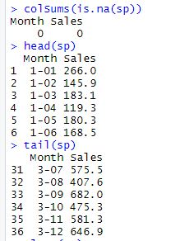

DATA HANDLING
Read the given dataset into csv
No missing values in the dataset.
The data contains two columns month and sales count of shampoo.
Head and Tail
Converted the csv dataset into time series dataset

Slide 4
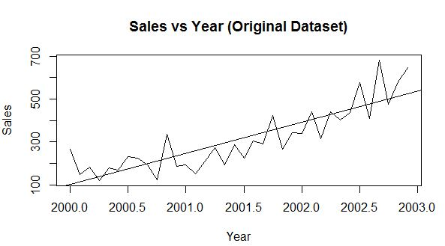
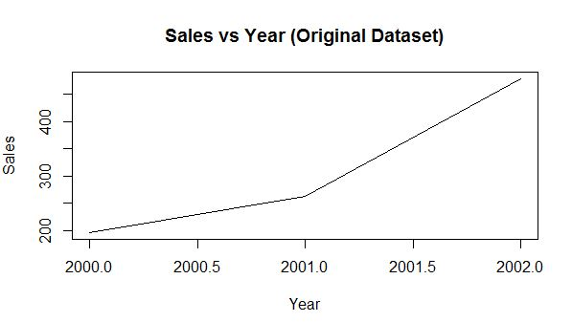
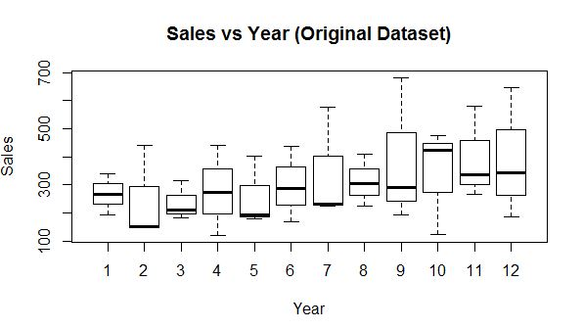
EDA

Slide 5
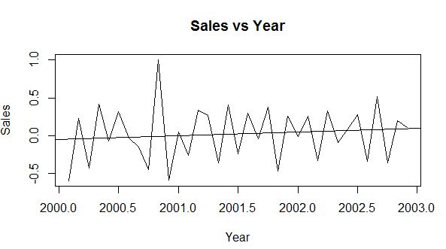
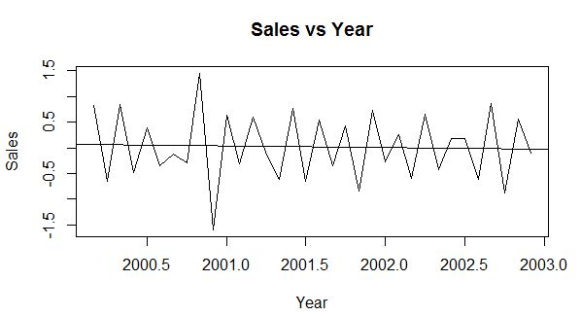
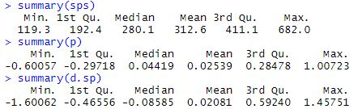
Differencing Using Log
1st degree
2nd degree

Slide 6
Dickey Fuller Test
Adf test :
On Original variable with lag order= 3, gives p-value= 0.9332 implies p-value is high, so we accept the null and reject the alternate. So, data is non-stationary.
On differenced variable with lag order=3 gives the same p-value = 0.01 which is less than 0.1, hence we can reject the null hypothesis and the data is stationary now.
On Second differenced variable with lag order=3 also gives the p-value = 0.01 which implies the data is stationary.

Slide 7
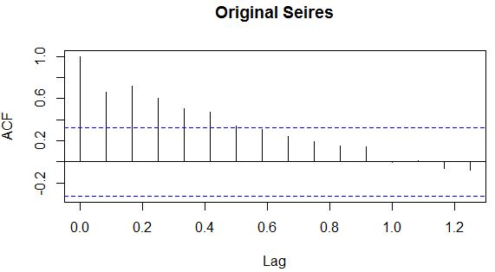
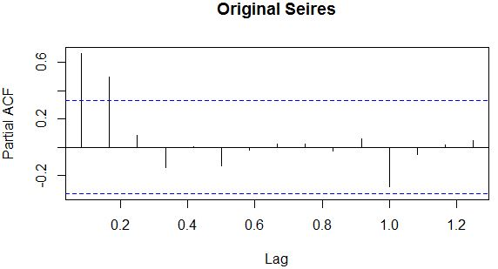
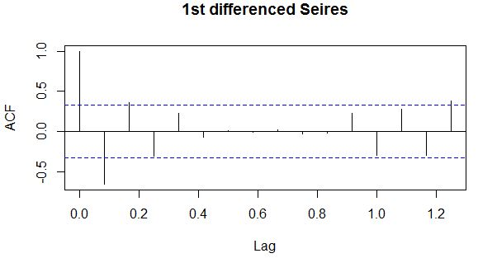
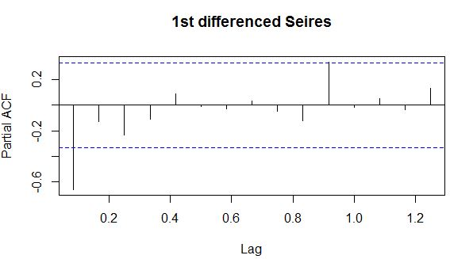
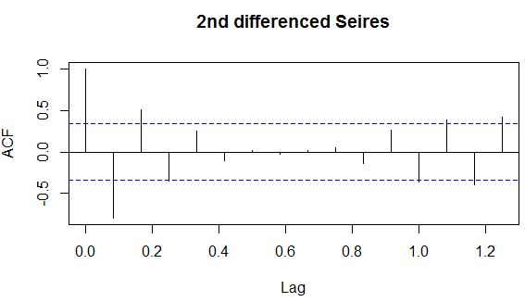
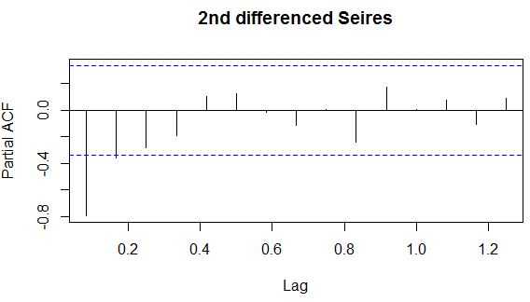
ACF
PACFACF

Slide 8
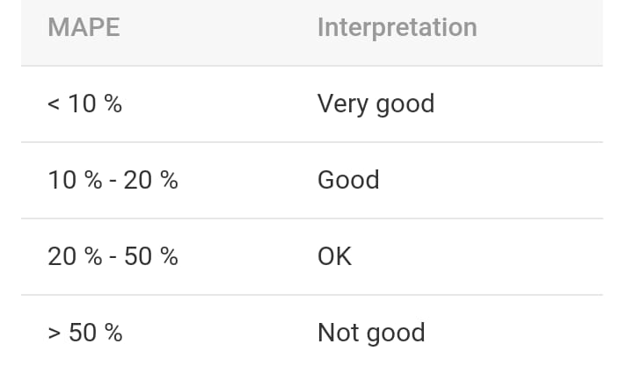
Split into Train and Test
Train dataset contains observations form 1-24.
Test dataset contains observations from 25-36.
Arima model of order (1,2,2)
AIC = 392.15
MAPE = 0.1296529
Auto Arima gives order (1,1,1) and (0,0,1) who’s AIC values are 406.83 and 457.17 resp and gives mape value of 17%.
Hence arima model of order (1,2,2) is a good.

Slide 9
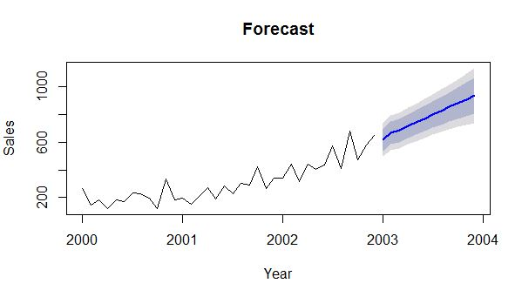
Forecasting
Forecasts of sales count of shampoo for the next 12 months.

Slide 10
THANK YOU

